Slide 1
COMMON ACCESSIBILITY CHECKLIST
ORB University
&
ANSI VS. ADA
ORB UNIVERSITY – JUNE 05, 2024
PRESENTED BY Theodore Cannon
Notes:
ASD ASD FASDF ASD FASFD

Slide 2
THE PURPOSE OF THIS PRESENTATION
To better understand ANSI and ADA as they relate to common area spaces.
To view common area accessibility in current ORB projects.
To give a generalized overview of the importance of the ORB accessibility checklist.

Slide 3
BACKGROUND: ACCESSIBILITY STANDARDS FOR COMMON AREAS
Building code (IBC, referencing ANSI A117.1)
Americans with Disabilities Act Standards for Accessible Design (ADA)
Notes:
TWO main sources for accessibility standards that influence how we design and inspect the common areas in our projects.

Slide 4
*FOR MORE ACCESSIBILITY INFORMATION
“ Theresa L. "Terry" Kitay focuses her practice on defense and preventive representation of clients in the housing industry in all civil rights matters.”
- Baker Donelson Website.
Terry Kitay “Housing Accessibility” presentation is located on the server in the ORB Resource Library > Accessibility Items

Slide 5
WHEN TO USE ANSI
Common area spaces outside of the leasing area
Accessible Type A and Type B units.
The surrounding site. IE: Crosswalks, accessible paths, gates, etc.

Slide 6
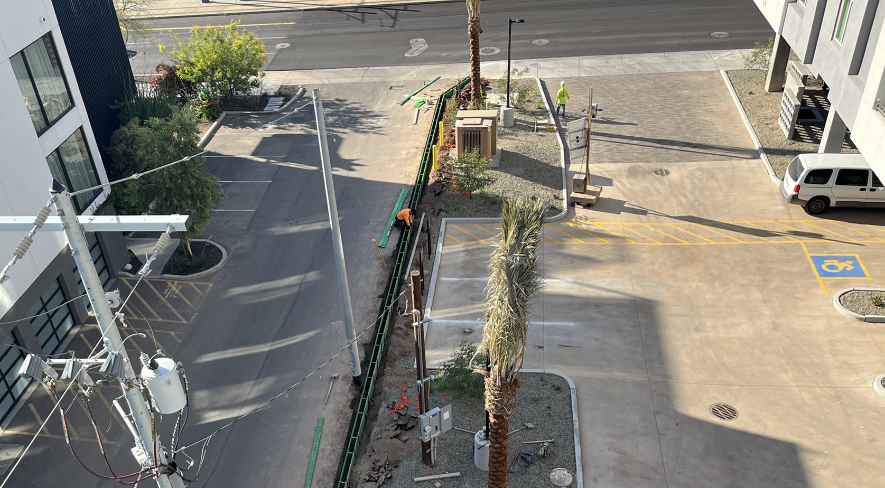
ACCESSIBILE SITE INSPECTIONS

Slide 7
WHEN TO USE ADA
Excerpt from Terry Kitay’s Accessibility Presentation
Applies to commercial facilities and "places of public accommodation" (Title III)
Applies to "programs" of state and local governments (Title II)
Limited application to housing (except publicly funded housing)
Limited application to multifamily: just “places of public accommodation” (Title III)

Slide 8
WHATS THE DIFFERENCE?
Both ANSI and ADA have similar applications, so how do I know when to use one or the other?
ADA: Limited application to multifamily: just “places of public accommodation” (Title III)
Leasing office(s)
Restroom(s) serving Leasing
Parking serving Leasing
Notes:
The only major difference is in the restroom(s) serving leasing. They have slight variations in toilet paper holder placement, AND grab bar installation is required.

Slide 9
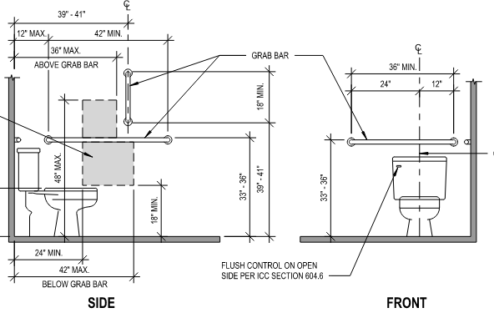
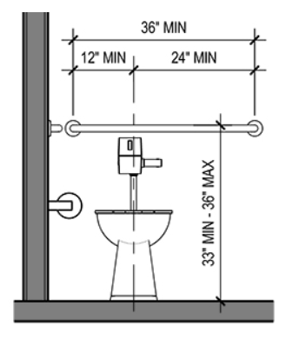
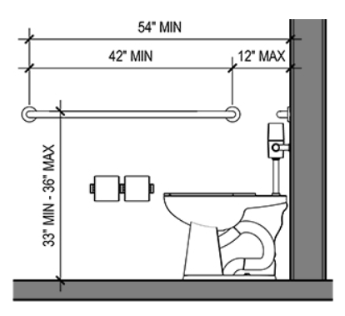
SLIGHT DIFFERENCES
ANSI requires the installation of a vertical grab bar at common access restrooms, ADA does not. ORB often opts for the most restrictive version.
SIDE
FRONT
ADA Figures 604.5.2
ANSI Figures 604.5

Slide 10
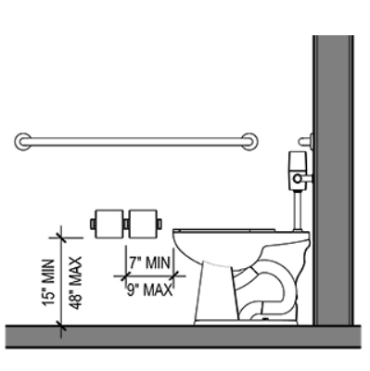
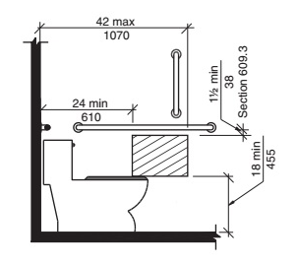
SLIGHT DIFFERENCES
Toilet paper dispensers have slight differences in their placement requirements. ORB often opts for the most restrictive version.
ADA Figure 604.7
ANSI Figure 604.7.1(A)

Slide 11
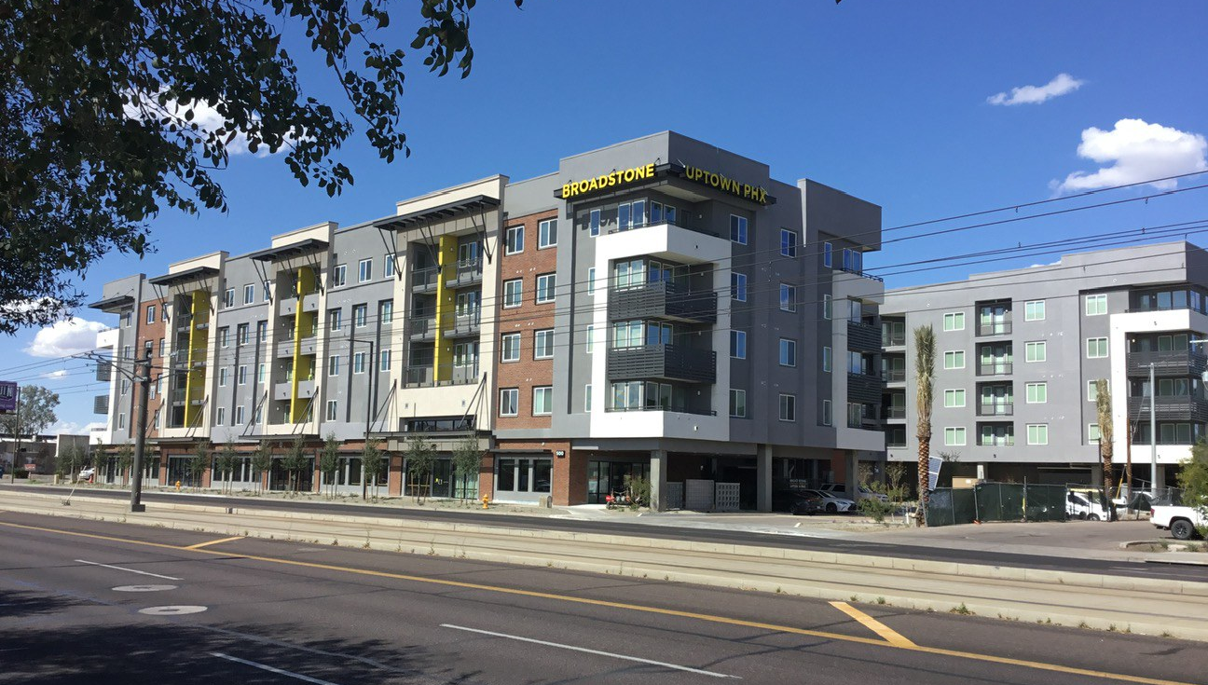
BROADSTONE UPTOWN

Slide 12
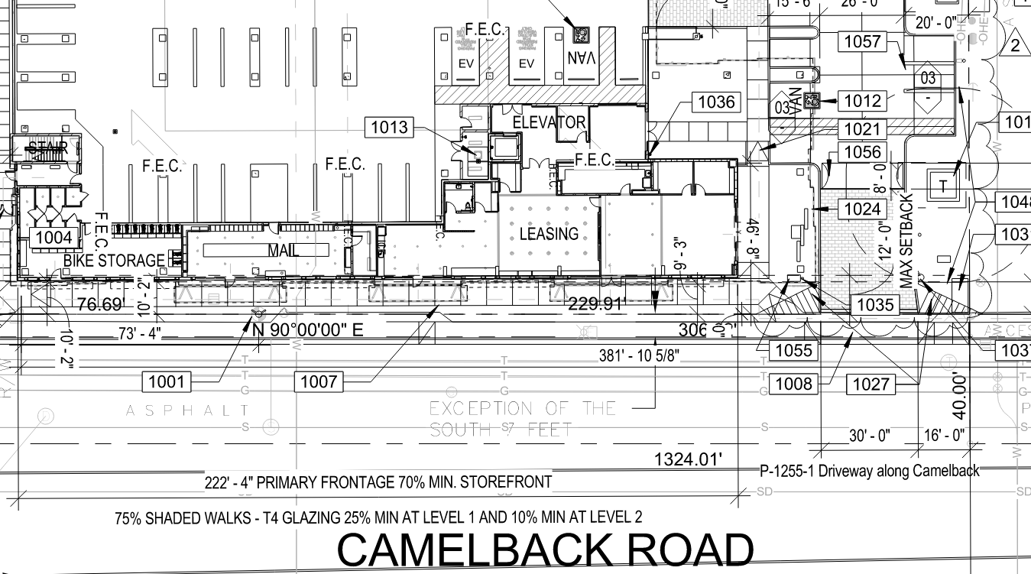

Slide 13
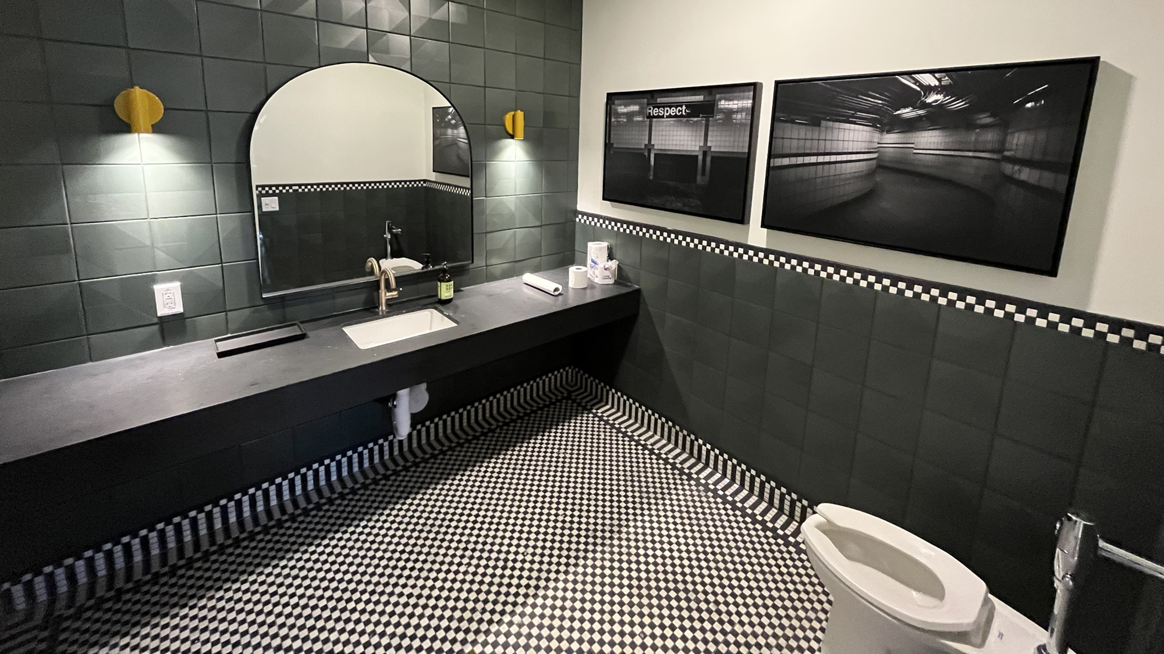
GRAB BAR TO BE PLACED
COUNTER HEIGHT – 34”
TP DISPENSER TO BE PLACED
OPEN KNEE SPACE

Slide 14
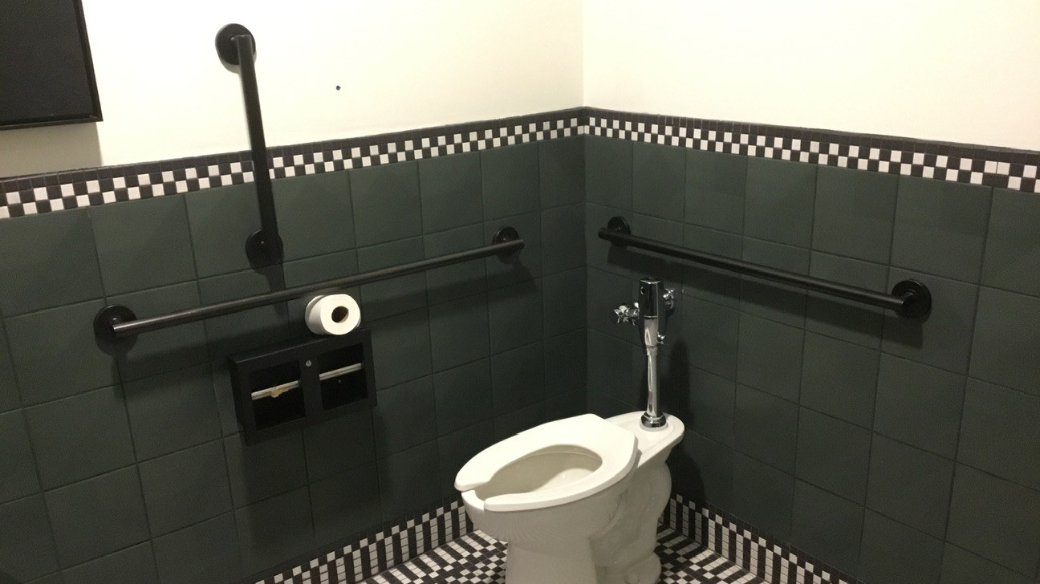

Slide 15
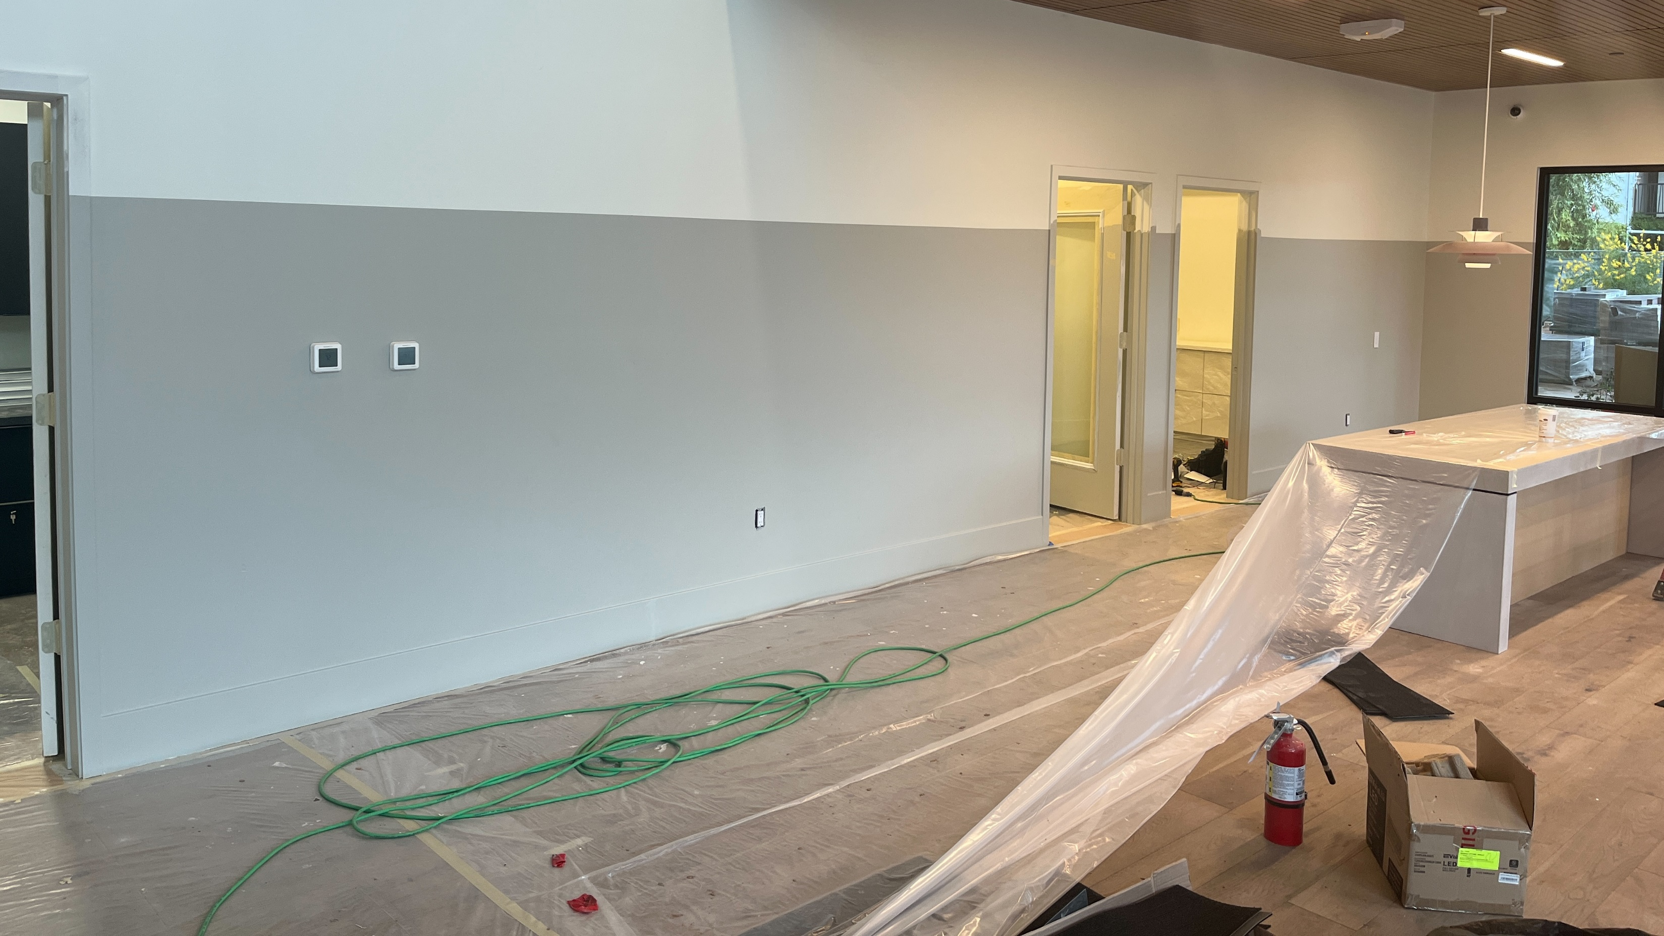
WORK ROOM (GRAY AREA)
ANSI or ADA?
KNEE SPACE
COUNTER HEIGHT

Slide 16
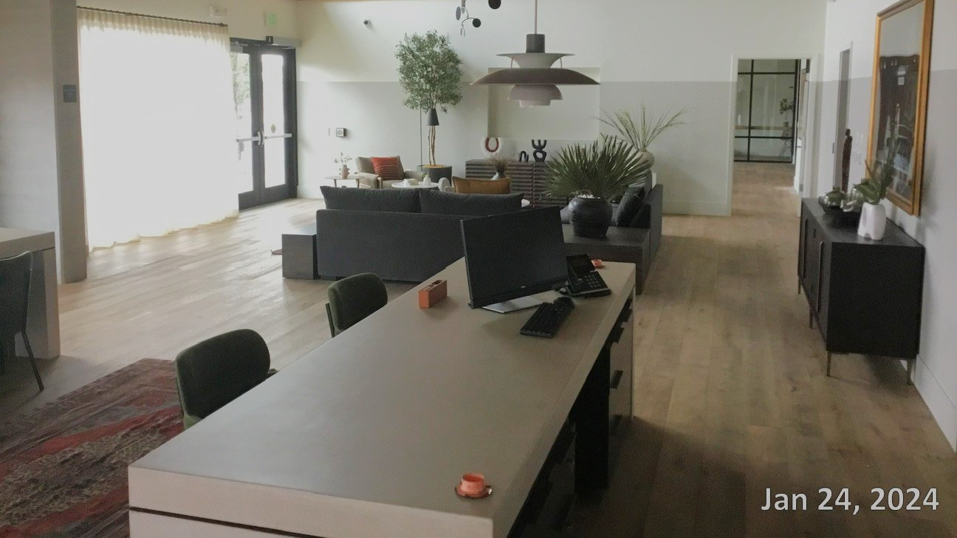

Slide 17
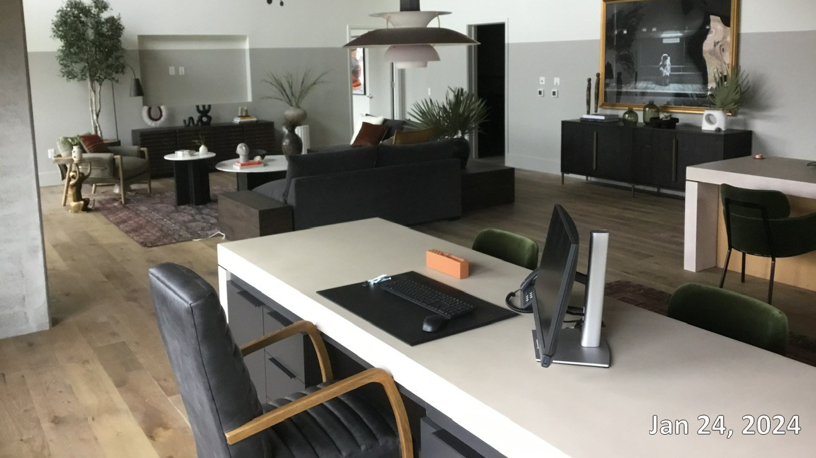

Slide 18
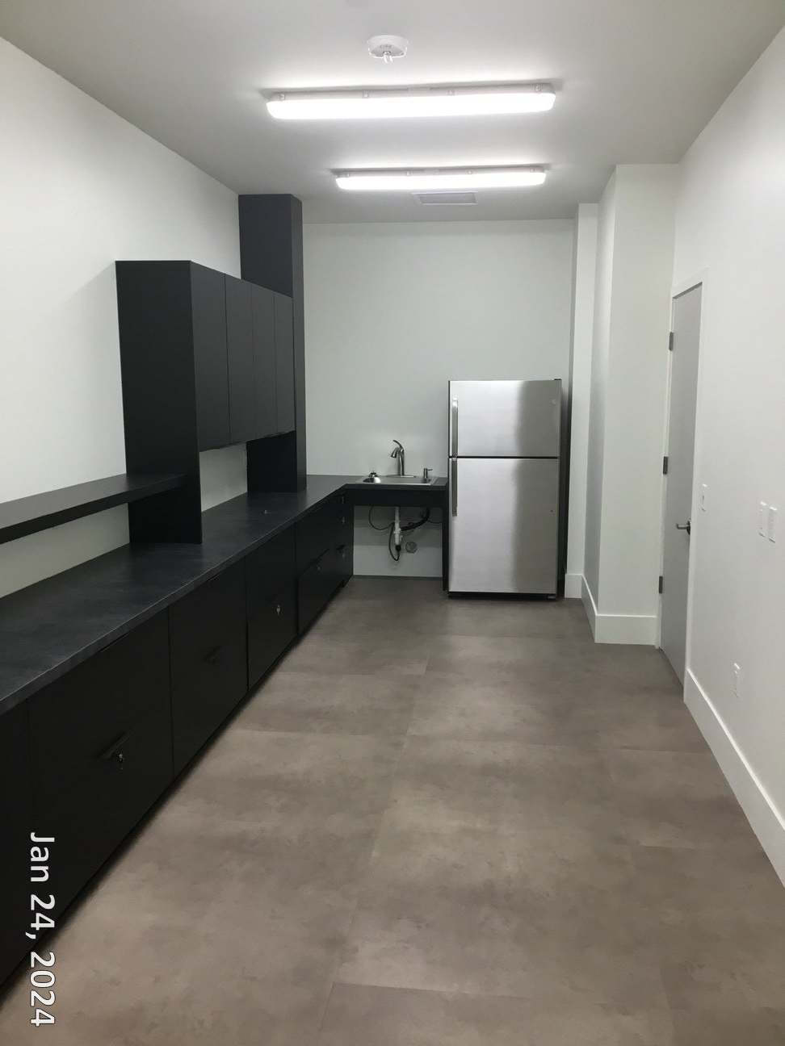

Slide 19
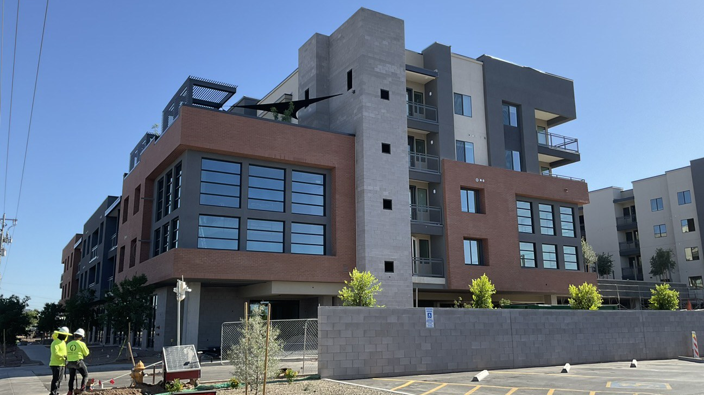
BROADSTONE on 7th

Slide 20
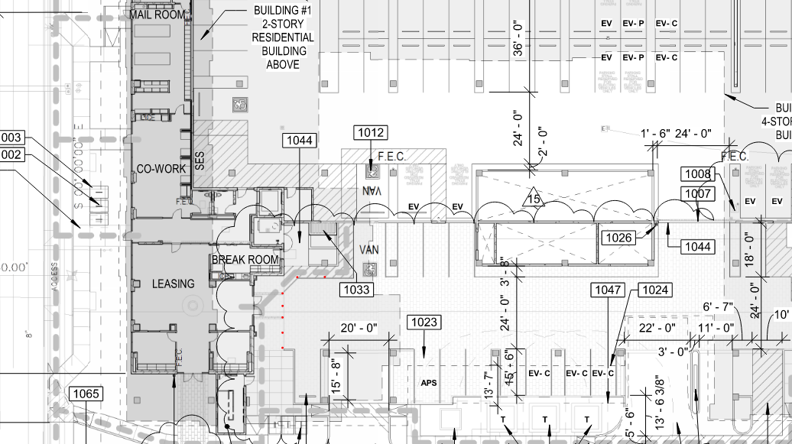

Slide 21
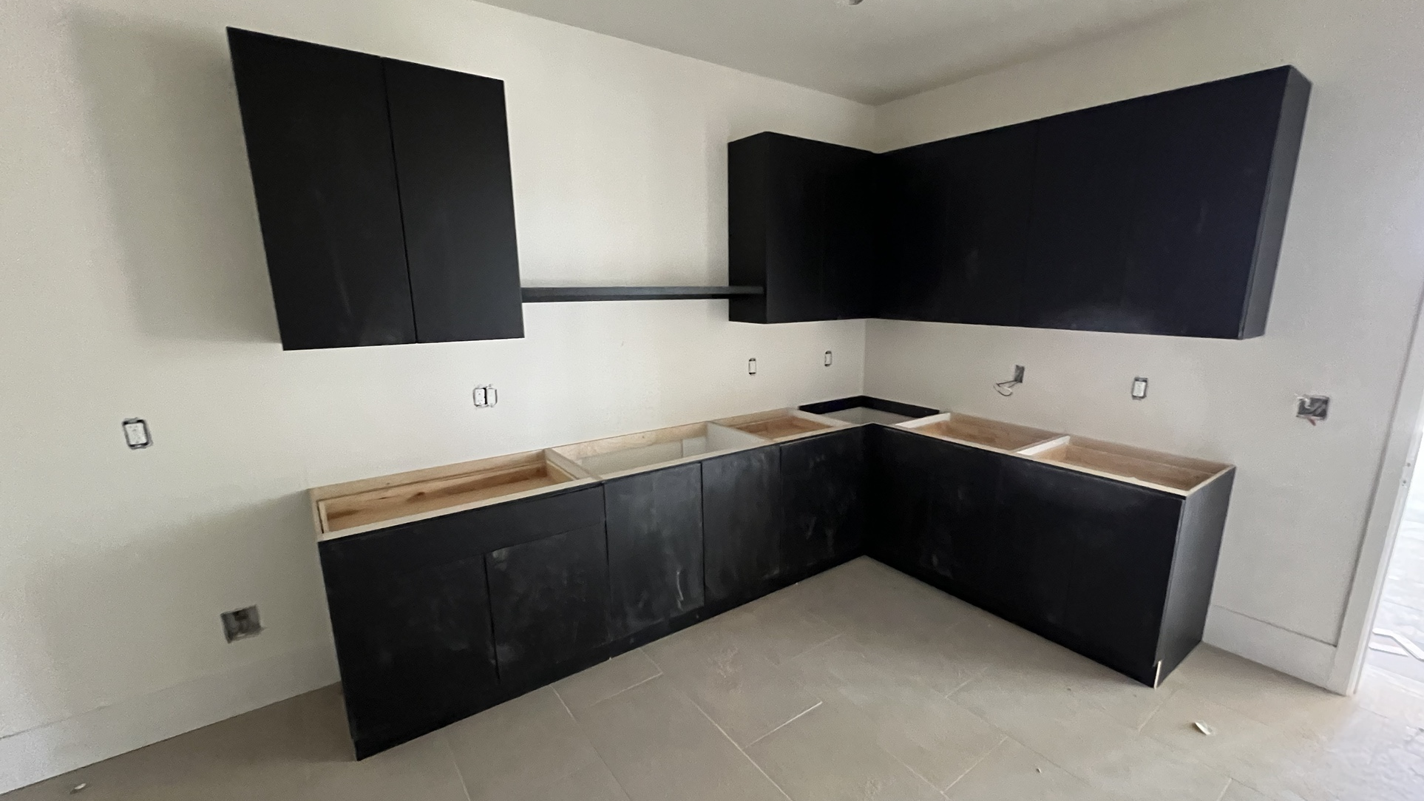
WORK ROOM (GRAY AREA)
COUNTER HEIGHT
OUTLET HEIGHT
ANSI /ADA 44”
Notes:
Why is the work room a gray area?

Slide 22
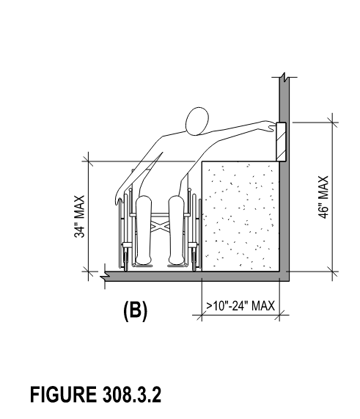
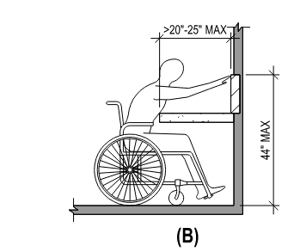
THE ANSI/ADA DETAIL
Most relevant code elements applicable to our projects are the same across both ANSI and ADA.
FIGURE 308.2.2

Slide 23
THE COMMON AREA FINISH CHECKLISTS

Slide 24
CHECKLIST LOCATION (IF APPLICABLE TO PROJECT)
When required, the checklists are/will be located in the following location.
T: Drive > ORB > ORB Resource Library > Accessibility items > Current Checklist > Common Area Checklist > Finish Checklists
Notes:
ORB will not be contracted to complete Accessibility Services for every project. …
*SEE ORB CHECKLIST IN ORB UNIVERSITY FOLDER

Slide 25
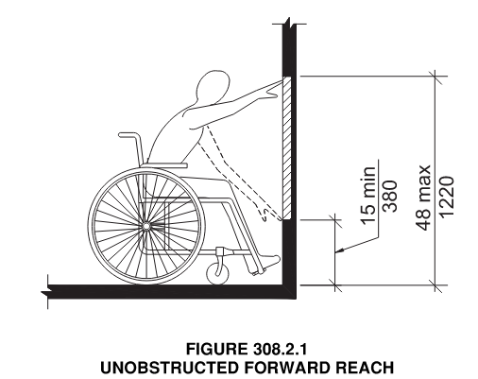
THE POOL AREA – CHECKLIST REVISION
Upon walking and inspecting Karen and I were made aware of an important inspection item required by our life safety…
VS
EXCERPT FROM COMMON AREA EXTERIOR CHECKLIST

Slide 26
BROADSTONE UPTOWN

Slide 27
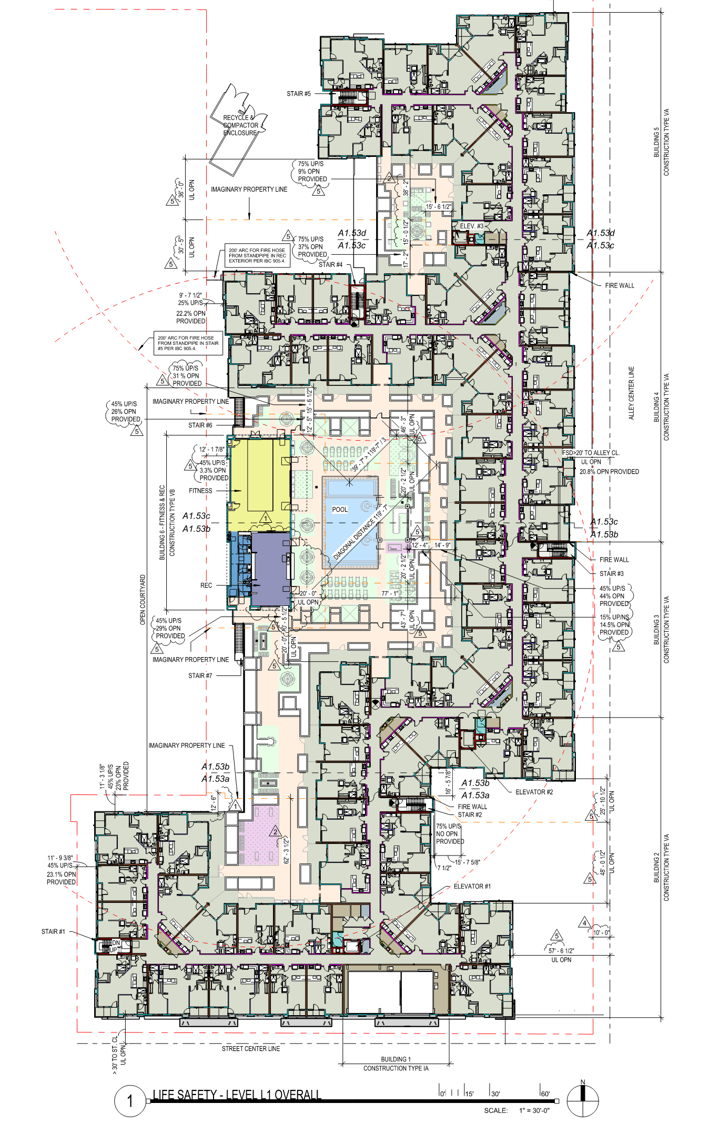
BROADSTONE UPTOWN

Slide 28
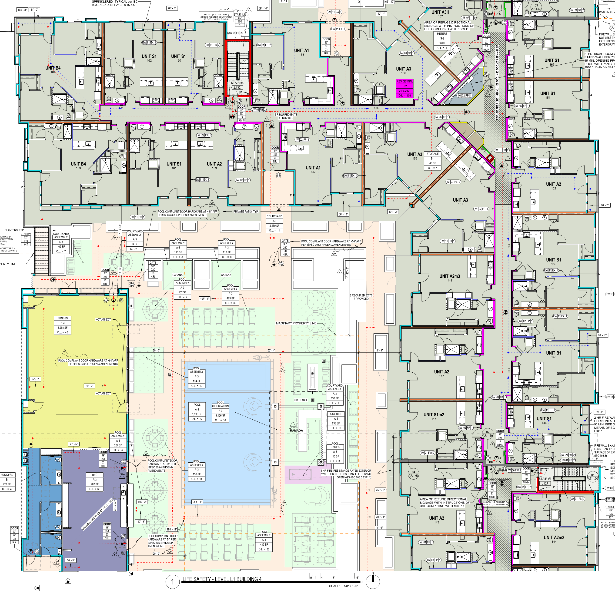
BROADSTONE UPTOWN

Slide 29
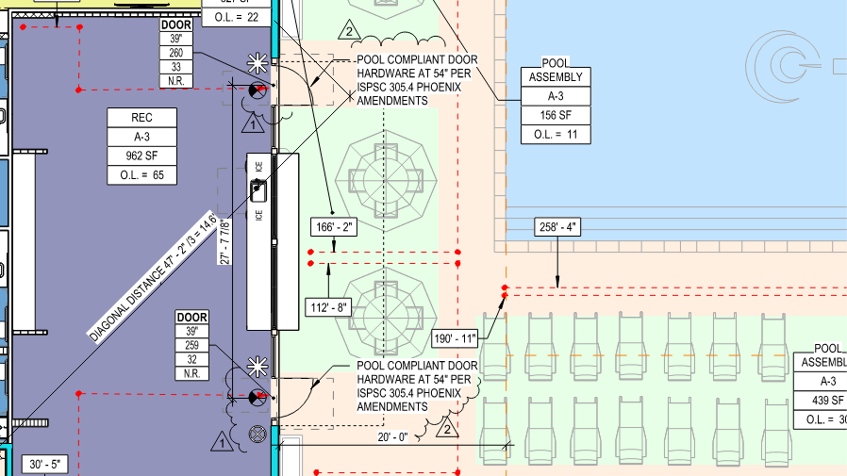

Slide 30
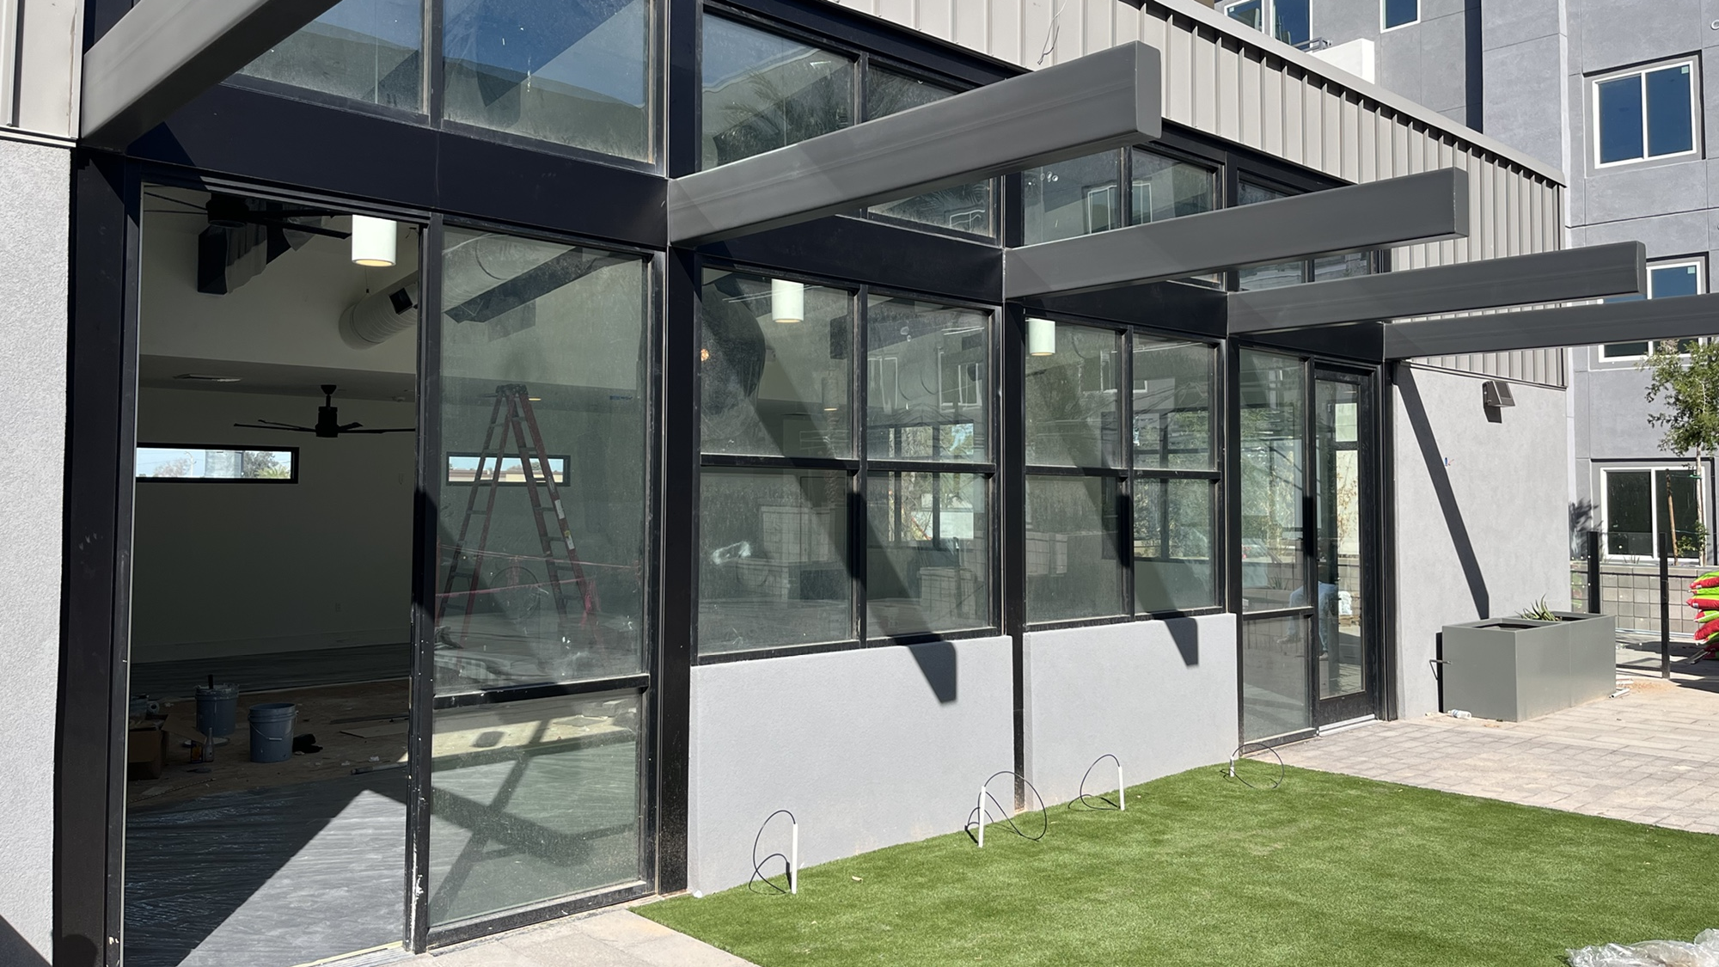

Slide 31
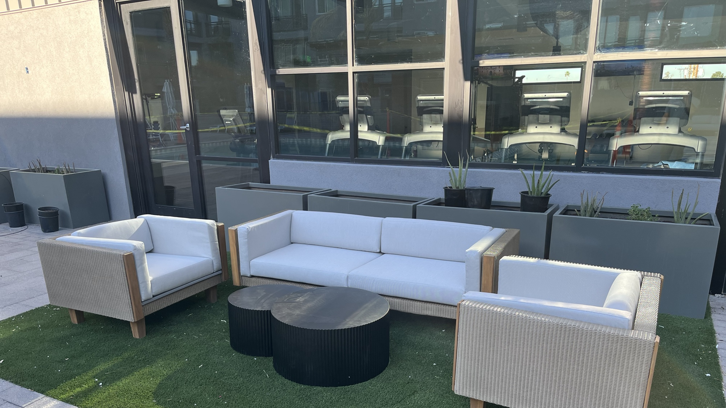

Slide 32
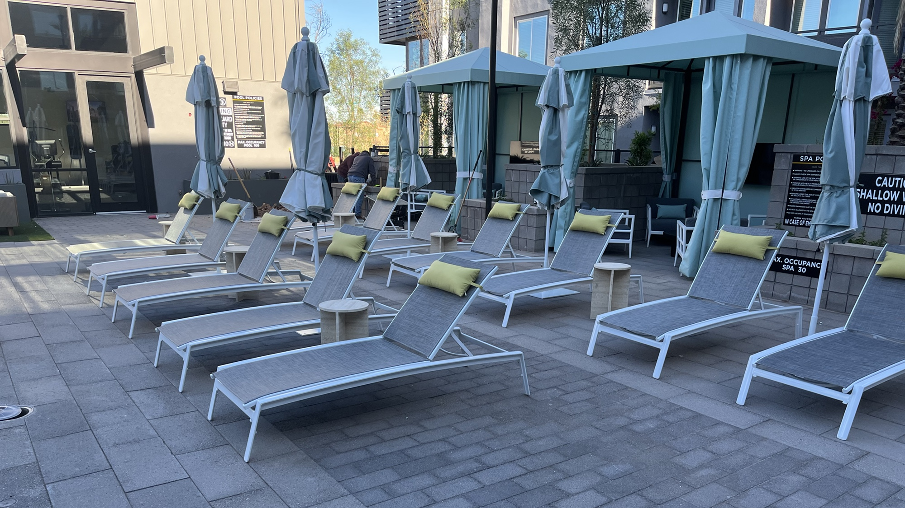

Slide 33
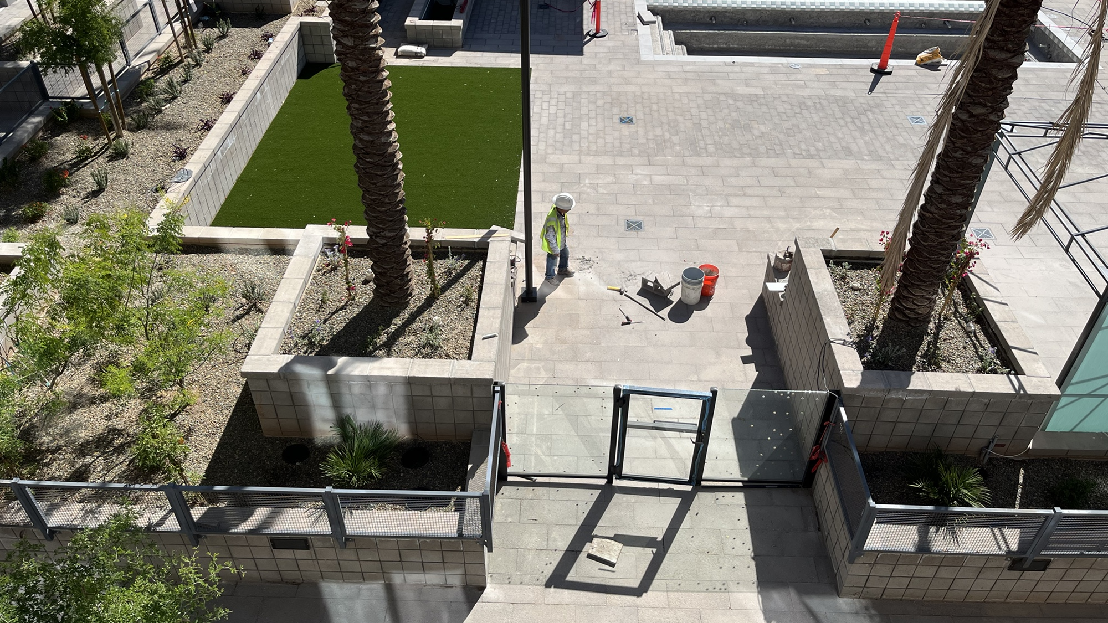

Slide 34
A COUPLE OF AREAS OF NON-COMPLIANCE

Slide 35
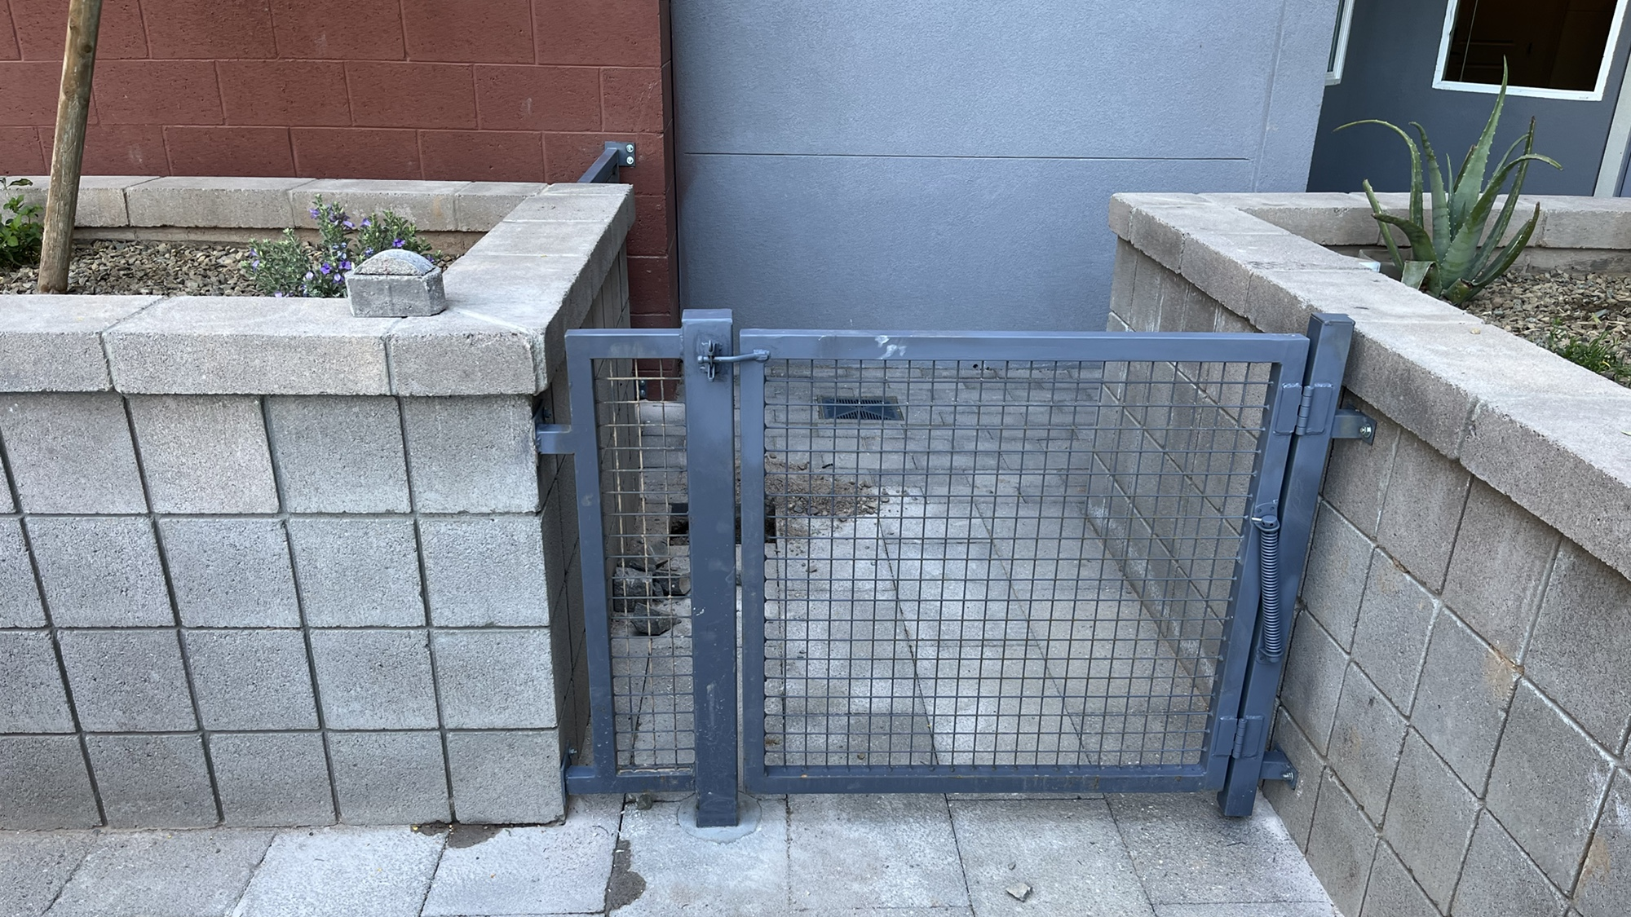
BROADSTONE UPTOWN
Notes:
Originally the “pull clearance” requirement was not satisfied for this condition. The gate was about 1 – 2 feet farther back originally. 18” on the latch side is necessary, so this gate had to be moved.

Slide 36
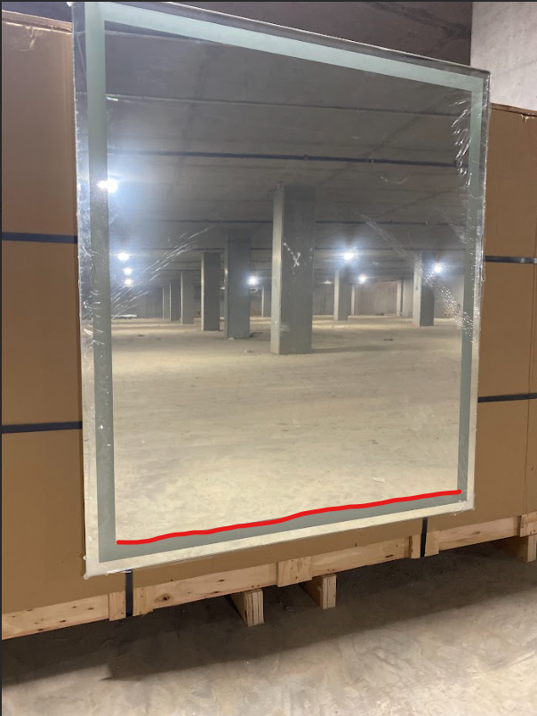
BROADSTONE DOBSON RANCH
BROADSTONE UPTOWN
Notes:
Originally the “pull clearance” requirement was not satisfied for this condition. The gate was about 1 – 2 feet farther back originally. 18” on the latch side is necessary, so this gate had to be moved.

